Slide 1
PCA analysis
Pei-Li Fu
2021-09-12

Slide 2
Principal Components Analysis ( PCA)
Principal Components Analysis ( PCA) is a technique that is useful for the compression and classification of data. The purpose is to reduce the dimensonality of a dataset by finding a new set of variables smaller thant the original set of variables (2D or 3D), that retains most of the sample information. 数据降维
The new variables, called principal components (PCs), are uncorrelated, and are ordered by the fraction of the total information each retains.

Slide 3
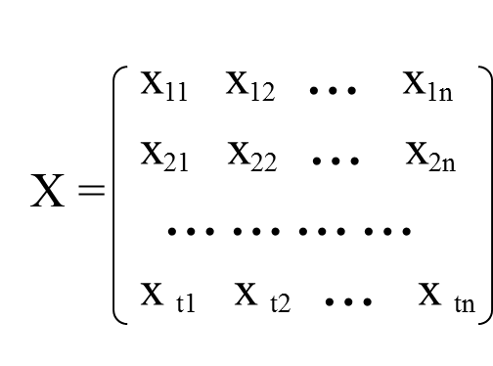
X₁, X₂, ….X_{n}

Slide 4
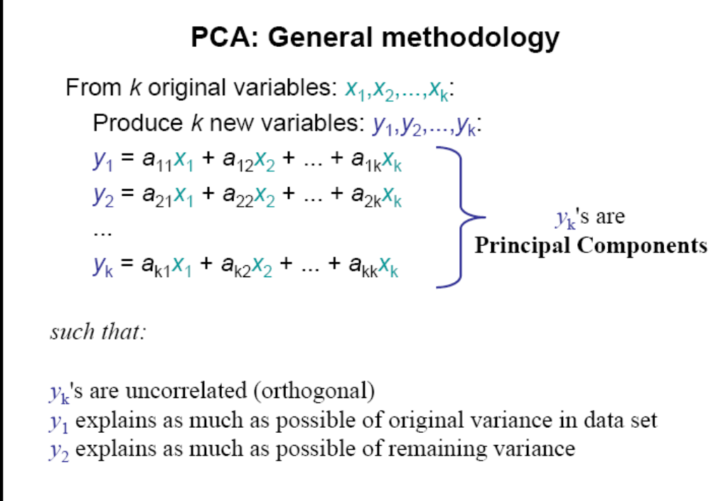

Slide 5
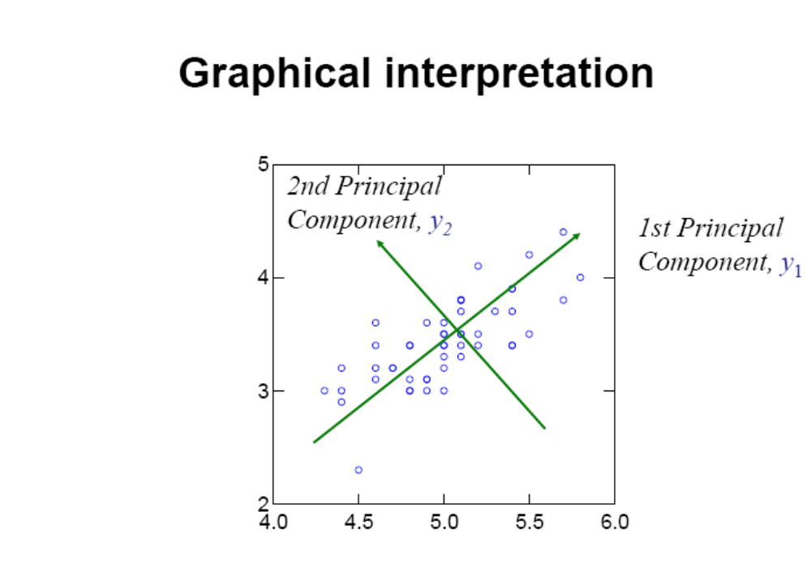

Slide 6
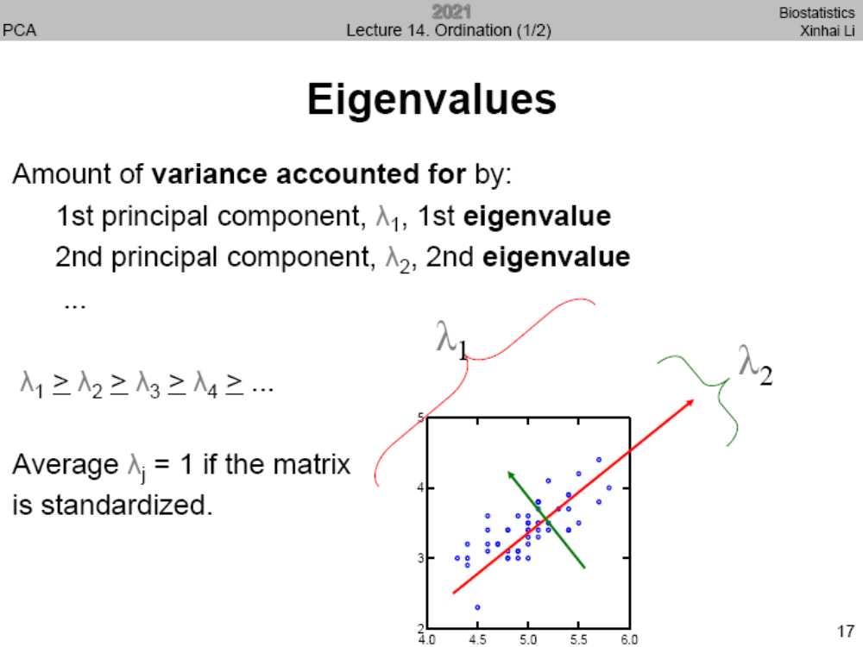
特征值

Slide 7
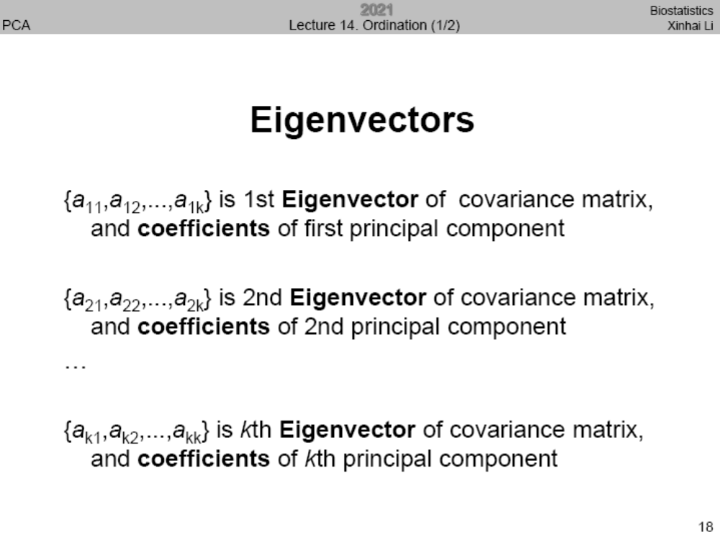
特征向量
特征向量为主成分的系数

Slide 8
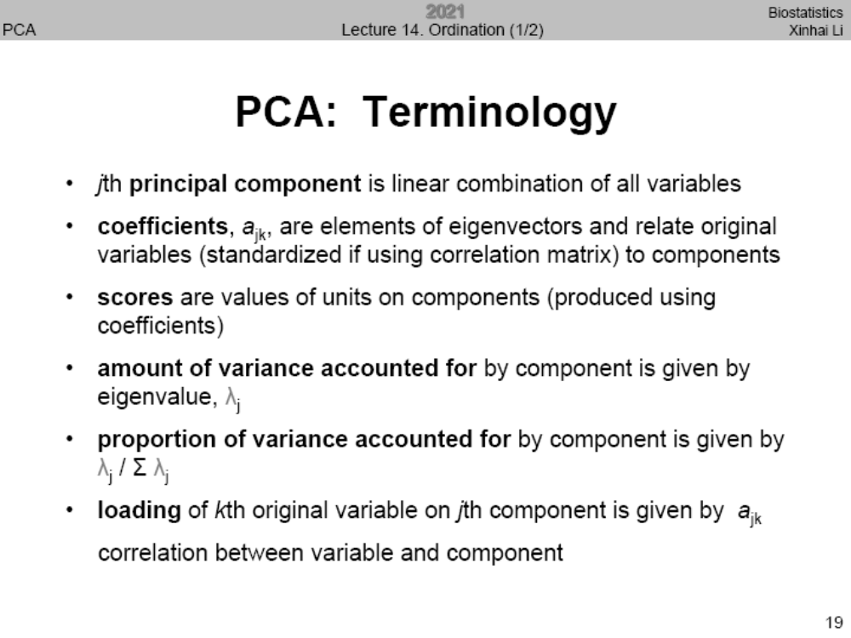

Slide 9
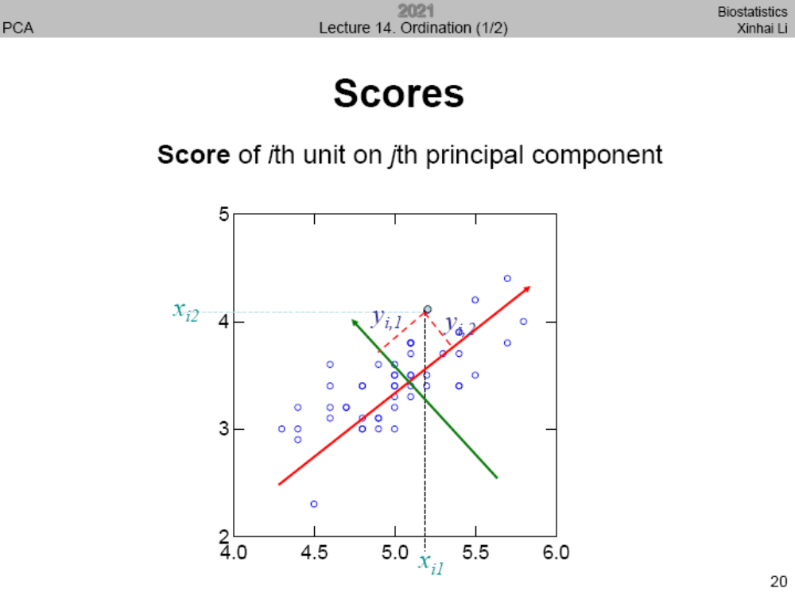

Slide 10
Steps of PCA
Scale and centered the data
Compute the covariance matrix C
Find the eigenvectors and eigenvalues of C.

Slide 11
Scale and center the data
test$WD <- scale(test$WD,scale = T,center = T)
test$WD
[1] 0.46 0.55 0.61 0.52 0.64 0.54 0.52 0.46 0.52 0.59 0.59 0.58 0.62 0.69
[15] 0.52 0.78 0.67 0.64 0.68 0.69 0.54
mean(test$WD) #close to zero
sd(test$WD) # is 1

Slide 12
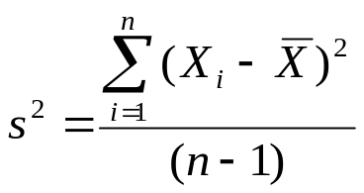
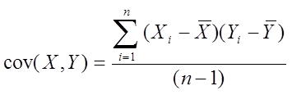
Variance and covariance matrix
Temperature
42
40
24
30
15
18
15
30
15
30
35
30
40
30
X=Temperature | Y=Humidity
40 | 90
40 | 90
40 | 90
30 | 90
15 | 70
15 | 70
15 | 70
30 | 90
15 | 70
30 | 70
30 | 70
30 | 90
40 | 70
30 | 90
Single variable
Two variables

Slide 13
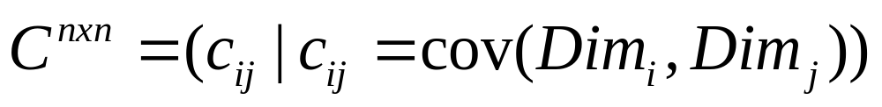
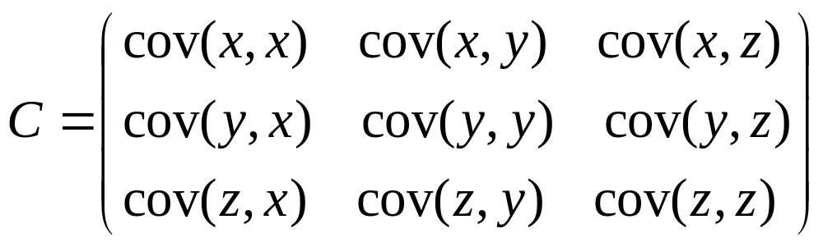
Covariance matrix for three variables
Contains covariance values between all possible dimensions (=attributes):
Example for three attributes (x,y,z):

Slide 14
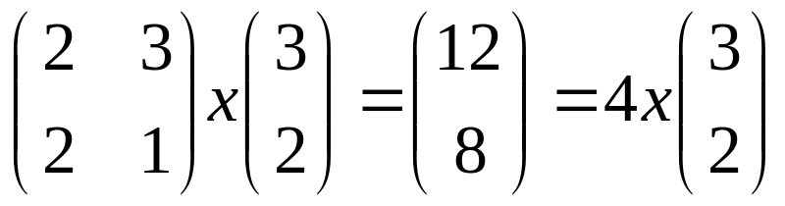
Eigenvalues & eigenvectors
Vectors x having same direction as Ax are called eigenvectors of A (A is an n by n matrix).
In the equation Ax=λx, λ is called an eigenvalue of A.
x
A *
x =
λ *
特征值与特征向量：几乎所有的向量在乘以矩阵A后都会改变方向，某些特殊的向量x和Ax位于同一个方向，它们称之为特征向量。 Ax = λx 。 λ为特征值。

Slide 15
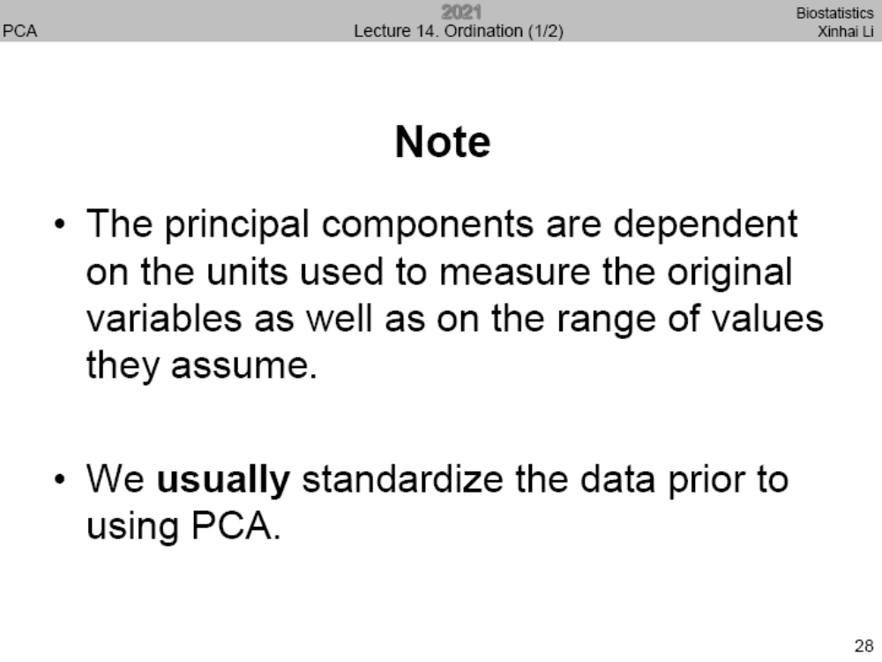

Slide 16
PCA in R
("FactoMineR") # Do PCA analysis
library("factoextra") #draw figures based on PCA

Slide 17
1. Scale each of the variables to have a mean of 0 and a standard deviation of 1.
SLA | Nm | Pm
204.6 | 36.6 | 2.5
199 | 28 | 2
228.8 | 41.1 | 2.91
127.7 | 19.1 | 1.5
160.3 | 26.2 | 2.3
226 | 38.6 | 2.9
313.9 | 34.6 | 2
91.7 | 25.4 | 1.9
144 | 18.8 | 1.7
160 | 26.6 | 1.5
181.5 | 23.2 | 1.7
161.3 | 24.7 | 1.5
58.1 | 22.2 | 1.1
153 | 21.1 | 1.6
127.2 | 18.8 | 1.4
87.4 | 14.5 | 1
127.6 | 21.2 | 1.9
159 | 29.4 | 1.6
151 | 20.1 | 1.4
85.2 | 17.5 | 1.1
142.2 | 16.6 | 1.1
test$SLA <- scale(test$SLA,scale = T,center = T)
test$Nm <- scale(test$Nm,scale = T,center = T)
test$Pm <- scale(test$Pm,scale = T,center = T)

Slide 18
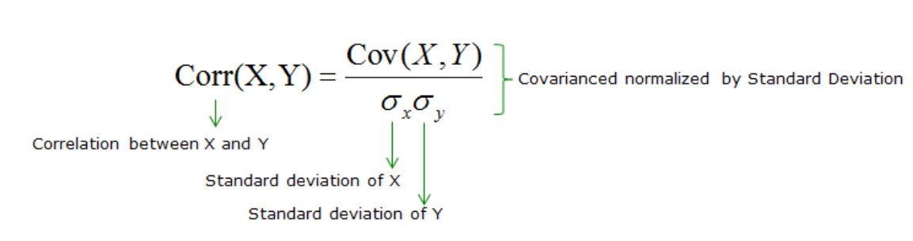
2. Calculate the covariance matrix for the scaled variables.
cov(test) #covariance matrix, they are identical to cor (test)
SLA Nm Pm
SLA 1.0000000 0.7541803 0.6748475
Nm 0.7541803 1.0000000 0.8747850
Pm 0.6748475 0.8747850 1.0000000
Why？

Slide 19
3. Calculate the eigenvalues of the covariance matrix.
eigen(cor(test))
eigen() decomposition
$values eigenvalues
[1] 2.5388634 0.3462418 0.1148948
$vectors eigenvectors
[,1] [,2] [,3]
[1,] -0.5491631 0.8161079 0.1799662
[2,] -0.5998960 -0.2350256 -0.7647795
[3,] -0.5818459 -0.5279497 0.6186473

Slide 20
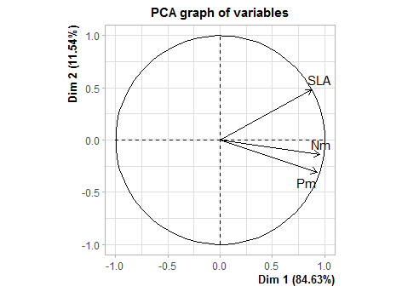
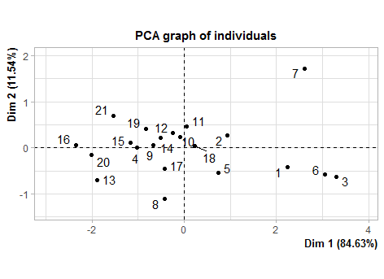

Slide 21
Another example of ecological data
Plant functional traits of limestone tree species
Deciduous :11 ; Evergreen:10
Variables : SLA Nm Pm Na Pa gs Aa Am LT

Slide 22
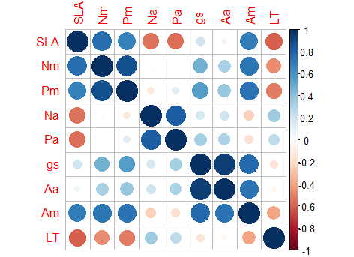
Corrplot
corrplot(cor(limestone[,4:12]),sig.level = 0.05,insig = c( "blank"))

Slide 23
PCA in R
{FactoMineR}
data are scaled to unit variance
data
number of dimensions
PCA(X, scale.unit = TRUE, ncp = 5, ind.sup = NULL,
quanti.sup = NULL, quali.sup = NULL, row.w = NULL, col.w = NULL, graph = TRUE, axes = c(1,2))

Slide 24
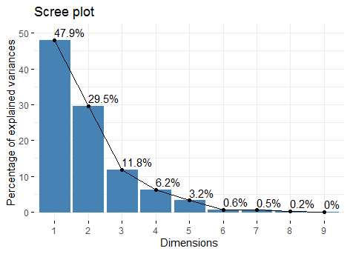

Slide 25
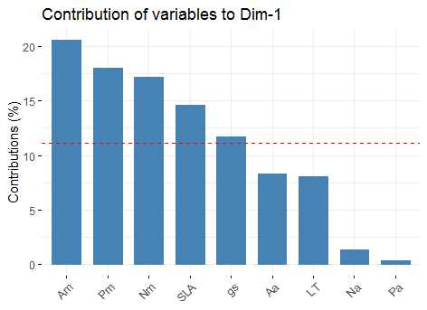
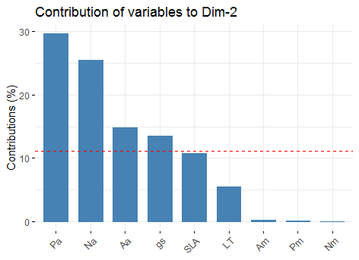
fviz_contrib(my_pca, choice = "var", axes = 1)
fviz_contrib(my_pca, choice = "var", axes = 2)

Slide 26
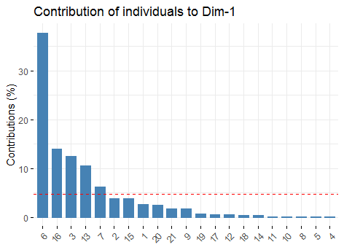
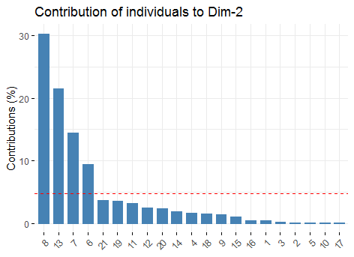
fviz_contrib(my_pca, choice = "ind", axes = 1)
fviz_contrib(my_pca, choice = "ind", axes = 2)

Slide 27
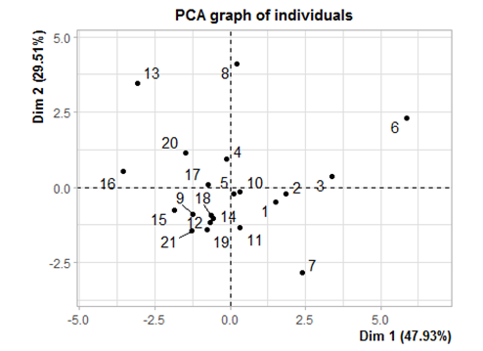

Slide 28
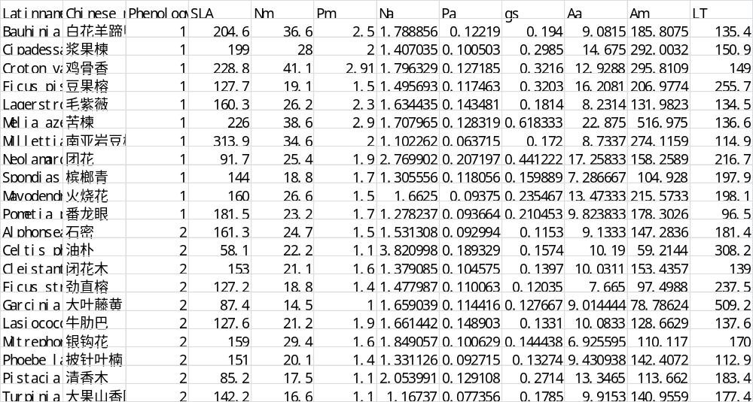

Slide 29
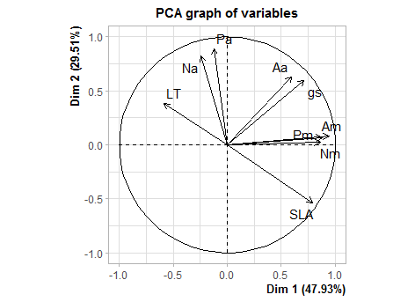
Plot for variable
fviz_pca_var(my_pca, geom = c("point", "text"),
col.var = "black",circlesize=0.5,
pointsize=1, labelsize = 2,repel = T,font.main=10)+# repel =T no overlap
theme(text = element_text(size = 7.5),
axis.title = element_text(size =10),
axis.text = element_text(size = 10))

Slide 30
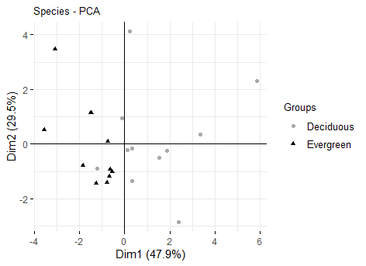
Plot for individual
fviz_pca_ind(my_pca,
geom.ind = "point", # show points only (nbut not "text")
col.ind = limestone$Phenology, # color by groups
palette = c("darkgrey", "black"),
addEllipses = F, # Concentration ellipses
legend.title = "Groups",mean.point = FALSE,axes.linetype = "solid",
text = element_text(size = 7.5),
axis.title = element_text(size =7.5),
axis.text = element_text(size = 7.5),title="Species - PCA",
font.main=10,font.legend=10
)

Slide 31
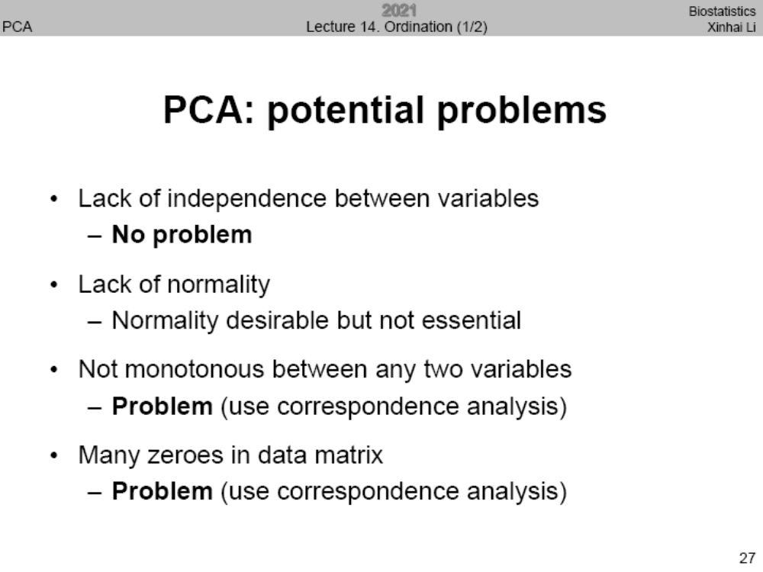

Slide 32
Ordination
Principal component analysis (PCA)
Factor analysis (FA)
Correspondence analysis (CA)
Principal coordinate analysis (PCoA) or multidimensional scaling (MDS)
Non-metric multidimensional scaling (NMDS)
Redundancy analysis (RDA)
Canonical correspondence analysis (CCA)
Generalized Joint Attribute Modeling (GJAM)

Slide 33
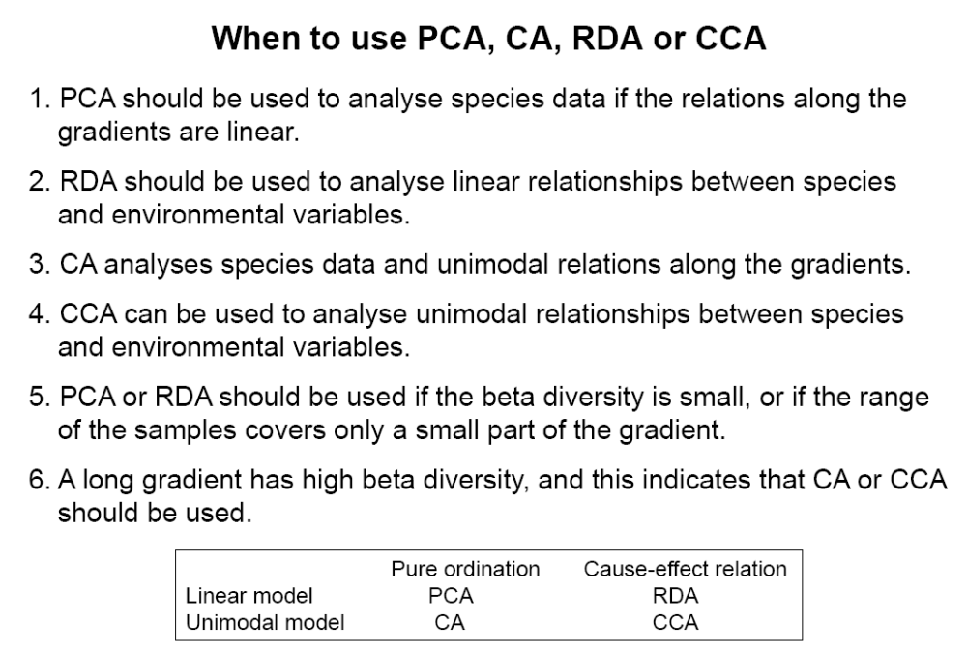
单纯排序 因果关系
线性模型
单峰模型

